Slide 1
Merge API Design
Luke Machowski
9th August 2019

Slide 2
Objectives
Clean API to merge content from one commit/branch to another.
Allow for callbacks to handle merge conflicts.
Extensible framework to allow different merge strategies.

Slide 3
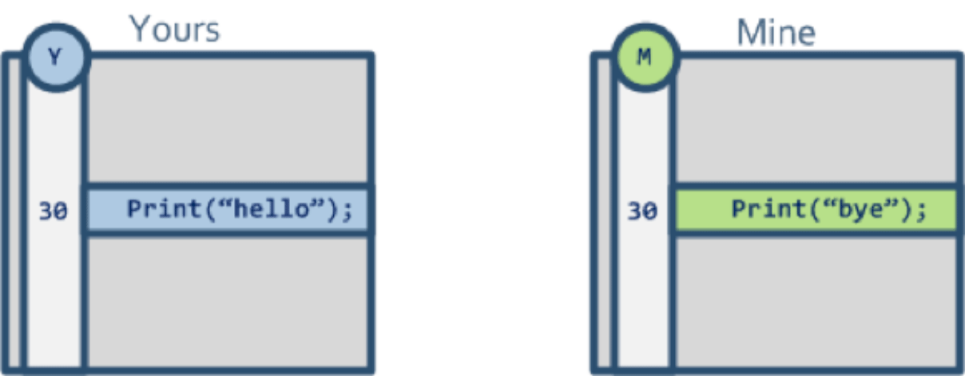
2 Way Merge
Suppose we're modifying the same file concurrently. You go and make some changes to the file and then I make some more changes.
At some point in time, someone looks at the two copies of the file and they see something like Figure 1:
This third person looking at the files sees there's a difference on line 30 but:
How can he tell whether you modified line 30 or if I modified it?
What if we both modified the line? How can he tell?
He can't.
He will have to call both of us and trust our memories to find out who modified what. And yes, fortunately we programmers never forget, right? ;-)
This "third person" is likely to actually be the version control system trying to do a simple two-way merge, which just compares two versions of a file and tries to merge them. But here, the VCS will require user intervention because it won't be able to figure out what to do.
It is better to avoid concurrent modifications on a file if you have to rely on two-way merge because it will be a slow manual process. Imagine 300 files requiring a simple merge…it would take ages to complete!
http://www.drdobbs.com/tools/three-way-merging-a-look-under-the-hood/240164902

Slide 4
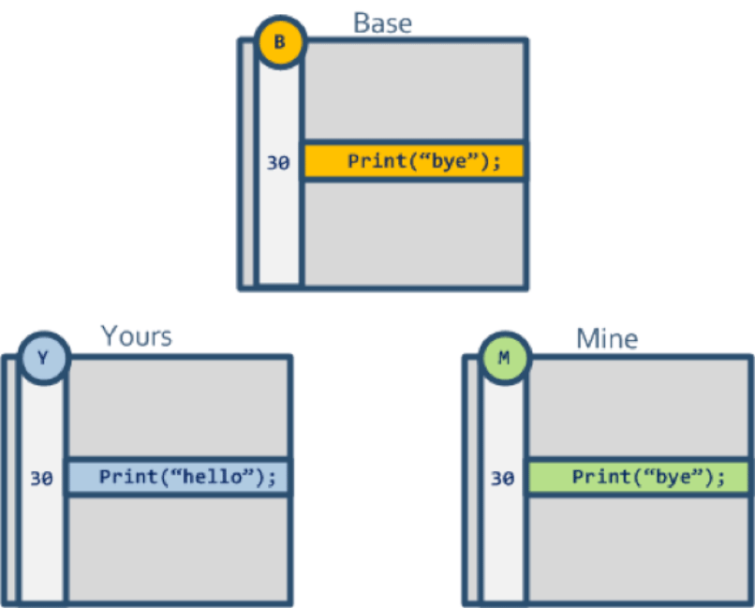
3 Way Merge
Let's forget for a second about version control, and go back to this "third person" looking into the two files we modified: How can he figure out what happened by himself?
He can look into the original version of the file we both used as starting point (Figure 2):
Then, looking at how the file was originally ("base common ancestor" or simply "base"), he can figure out what to do.
Based on Figure 2, only one developer actually changed line 30, so the conflict can be manually resolved: Just keep "Yours" as the solution, so it will say: Print("hello");
This is how three-way merge helps: It turns a manual conflict into an automatic resolution. Part of the magic here relies on the VCS locating the original version of the file. This original version is better known as the "nearest common ancestor." The VCS then passes the common ancestor and the two contributors to the three-way merge tool that will use all three to calculate the result.
Using two-way merge only, the lines modified by two developers will require manual intervention, while everything else will be automatically merged. With three-way merge, it is possible to run a painless merge involving hundreds of files.
http://www.drdobbs.com/tools/three-way-merging-a-look-under-the-hood/240164902

Slide 5
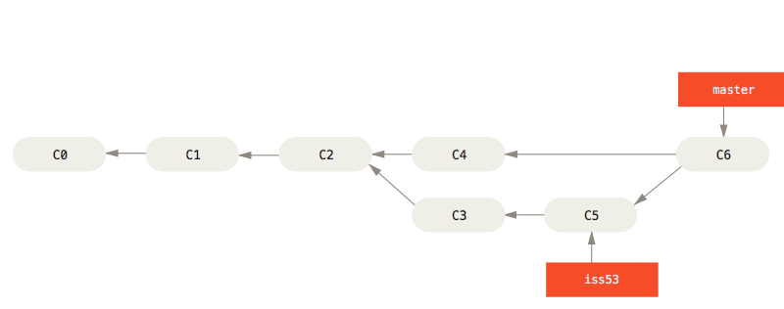
Git Branching and Merging
Instead of just moving the branch pointer forward, Git creates a new snapshot that results from this three-way merge and automatically creates a new commit that points to it. This is referred to as a merge commit, and is special in that it has more than one parent.
https://git-scm.com/book/en/v2/Git-Branching-Basic-Branching-and-Merging

Slide 6
3 Way Merge Algorithm
You might be best off looking for a description of a 3-way merge algorithm. A high-level description would go something like this:
Find a suitable merge base B - a version of the file that is an ancestor of both of the new versions (X and Y), and usually the most recent such base (although there are cases where it will have to go back further, which is one of the features of gits default recursive merge)
Perform diffs of X with B and Y with B.
Walk through the change blocks identified in the two diffs. If both sides introduce the same change in the same spot, accept either one; if one introduces a change and the other leaves that region alone, introduce the change in the final; if both introduce changes in a spot, but they don't match, mark a conflict to be resolved manually.
The full algorithm deals with this in a lot more detail, and even has some documentation (/usr/share/doc/git-doc/technical/trivial-merge.txt for one, along with the git help XXX pages, where XXX is one of merge-base, merge-file, merge, merge-one-file and possibly a few others). If that's not deep enough, there's always source code...
https://stackoverflow.com/a/14962580/231860

Slide 7
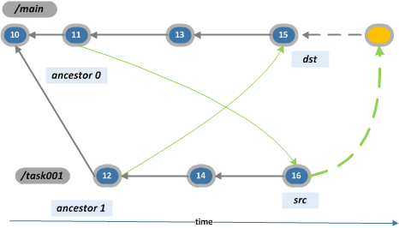
Merge Recursive Strategy
What if we find "two common ancestors"? The branch explorer view below shows an alternative in which there are two possible "common ancestors".
While this won't happen frequently, it is really likely to happen with long lived branches or complex branch topologies. (The case depicted above is the shortest one driving to the "multiple ancestor" problem, but it can happen too with several changesets and branches in between the "crossed" merges). One solution is to "select" one of the ancestors as the valid one for the merge (which is the option Mercurial takes) but as we will see below, it has many drawbacks.
http://blog.plasticscm.com/2011/09/merge-recursive-strategy.html

Slide 8
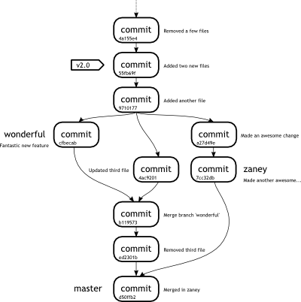
Git in the Trenches: Merge-Merge-Merge
How does merging work?
To start with, we need to define which merging strategy we are talking about. In Git there are multiple ways to instruct a merge to take place. Below is a brief list of the options that you can supply to the git merge command along with a brief description of how each one affects the merge process. We will explain the details a little more further on.
Resolve - A two headed merge strategy using a 3-way merge algorithm. This is used by default in Git.
Recursive - A two headed merge strategy using a 3-way merge algorithm. This algorithm looks at situations where multiple common ancestors are eligible and creates a merged tree of the common ancestors to be used as a reference. Usually, this method has less conflicts and carries with it multiple sub-options.
Octopus - This merge strategy can merge in multiple heads. When trying to pull multiple topic branches into a single merge, an octopus is the default method that Git will use.
Ours - Another multiple head strategy, which simply ignores all changes from the other branches. At first it may sound like a useless idea, but it could be used to keep the history of a branch without actually keeping the branch itself.
Subtree - A much more advanced merge strategy based on the recursive which trees are adjusted to result in a better merge.
Now that we are aware of the different options available to us, let us discuss what happens when we actually perform a merge. Let us consider the state of our repository at the end of Week 4, as shown in Figure 1.
https://cbx33.github.io/gitt/afterhours4-1.html

Slide 9
Git Merge Documentation
DESCRIPTION
Incorporates changes from the named commits (since the time their histories diverged from the current branch) into the current branch. This command is used by git pull to incorporate changes from another repository and can be used by hand to merge changes from one branch into another.
Assume the following history exists and the current branch is "master":
A---B---C topic / D---E---F---G master
Then "git merge topic" will replay the changes made on the topic branch since it diverged from master (i.e., E) until its current commit (C) on top of master, and record the result in a new commit along with the names of the two parent commits and a log message from the user describing the changes.
A---B---C topic / \ D---E---F---G---H master
The second syntax ("git merge --abort") can only be run after the merge has resulted in conflicts. git merge --abort will abort the merge process and try to reconstruct the pre-merge state. However, if there were uncommitted changes when the merge started (and especially if those changes were further modified after the merge was started), git merge --abort will in some cases be unable to reconstruct the original (pre-merge) changes. Therefore:
Warning: Running git merge with non-trivial uncommitted changes is discouraged: while possible, it may leave you in a state that is hard to back out of in the case of a conflict.
The third syntax ("git merge --continue") can only be run after the merge has resulted in conflicts.
https://git-scm.com/docs/git-merge
https://git-scm.com/docs/git-merge#_merge_strategies

Slide 10
Git Merge Documentation – Merge Strategies
MERGE STRATEGIES
The merge mechanism (git merge and git pull commands) allows the backend merge strategies to be chosen with -s option. Some strategies can also take their own options, which can be passed by giving -X<option> arguments to git merge and/or git pull.
Resolve
This can only resolve two heads (i.e. the current branch and another branch you pulled from) using a 3-way merge algorithm. It tries to carefully detect criss-cross merge ambiguities and is considered generally safe and fast.
Octopus
This resolves cases with more than two heads, but refuses to do a complex merge that needs manual resolution. It is primarily meant to be used for bundling topic branch heads together. This is the default merge strategy when pulling or merging more than one branch.
Ours
This resolves any number of heads, but the resulting tree of the merge is always that of the current branch head, effectively ignoring all changes from all other branches. It is meant to be used to supersede old development history of side branches. Note that this is different from the -Xours option to the recursive merge strategy.
Subtree
This is a modified recursive strategy. When merging trees A and B, if B corresponds to a subtree of A, B is first adjusted to match the tree structure of A, instead of reading the trees at the same level. This adjustment is also done to the common ancestor tree.
With the strategies that use 3-way merge (including the default, recursive), if a change is made on both branches, but later reverted on one of the branches, that change will be present in the merged result; some people find this behavior confusing. It occurs because only the heads and the merge base are considered when performing a merge, not the individual commits. The merge algorithm therefore considers the reverted change as no change at all, and substitutes the changed version instead.
Recursive
This can only resolve two heads using a 3-way merge algorithm. When there is more than one common ancestor that can be used for 3-way merge, it creates a merged tree of the common ancestors and uses that as the reference tree for the 3-way merge. This has been reported to result in fewer merge conflicts without causing mismerges by tests done on actual merge commits taken from Linux 2.6 kernel development history. Additionally this can detect and handle merges involving renames, but currently cannot make use of detected copies. This is the default merge strategy when pulling or merging one branch.
The recursive strategy can take the following options:
Ours
This option forces conflicting hunks to be auto-resolved cleanly by favoring our version. Changes from the other tree that do not conflict with our side are reflected to the merge result. For a binary file, the entire contents are taken from our side.
This should not be confused with the ours merge strategy, which does not even look at what the other tree contains at all. It discards everything the other tree did, declaring our history contains all that happened in it.
theirs
This is the opposite of ours; note that, unlike ours, there is no theirs merge strategy to confuse this merge option with.
patience
With this option, merge-recursive spends a little extra time to avoid mismerges that sometimes occur due to unimportant matching lines (e.g., braces from distinct functions). Use this when the branches to be merged have diverged wildly. See also git-diff[1] --patience.
diff-algorithm=[patience|minimal|histogram|myers]
Tells merge-recursive to use a different diff algorithm, which can help avoid mismerges that occur due to unimportant matching lines (such as braces from distinct functions). See also git-diff[1] --diff-algorithm.
ignore-space-change
ignore-all-space
ignore-space-at-eol
ignore-cr-at-eol
Treats lines with the indicated type of whitespace change as unchanged for the sake of a three-way merge. Whitespace changes mixed with other changes to a line are not ignored. See also git-diff[1] -b, -w, --ignore-space-at-eol, and --ignore-cr-at-eol.
If their version only introduces whitespace changes to a line, our version is used;
If our version introduces whitespace changes but their version includes a substantial change, their version is used;
Otherwise, the merge proceeds in the usual way.
Renormalize
This runs a virtual check-out and check-in of all three stages of a file when resolving a three-way merge. This option is meant to be used when merging branches with different clean filters or end-of-line normalization rules. See "Merging branches with differing checkin/checkout attributes" in gitattributes[5] for details.
no-renormalize
Disables the renormalize option. This overrides the merge.renormalize configuration variable.
no-renames
Turn off rename detection. This overrides the merge.renames configuration variable. See also git-diff[1] --no-renames.
find-renames[=<n>]
Turn on rename detection, optionally setting the similarity threshold. This is the default. This overrides the merge.renames configuration variable. See also git-diff[1] --find-renames.
rename-threshold=<n>
Deprecated synonym for find-renames=<n>.
subtree[=<path>]
This option is a more advanced form of subtree strategy, where the strategy makes a guess on how two trees must be shifted to match with each other when merging. Instead, the specified path is prefixed (or stripped from the beginning) to make the shape of two trees to match.
https://git-scm.com/docs/merge-strategies
https://git-scm.com/docs/git-merge#_merge_strategies

